Slide 1
Lesson3
IR led and wireless communication basics
Tongtong, Mike, Ethan

Slide 2
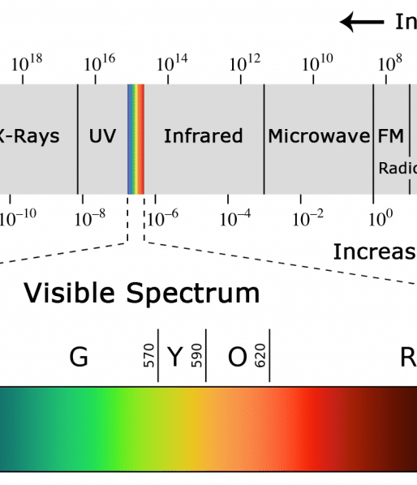
What is infrared
Infrared (IR) radiation is a type of light similar to visible light.
The main difference between IR light and visible light is their frequency and wavelength.
IR radiation is outside the range of visible light, not visible to naked eye.
https://www.circuitbasics.com/arduino-ir-remote-receiver-tutorial/

Slide 3
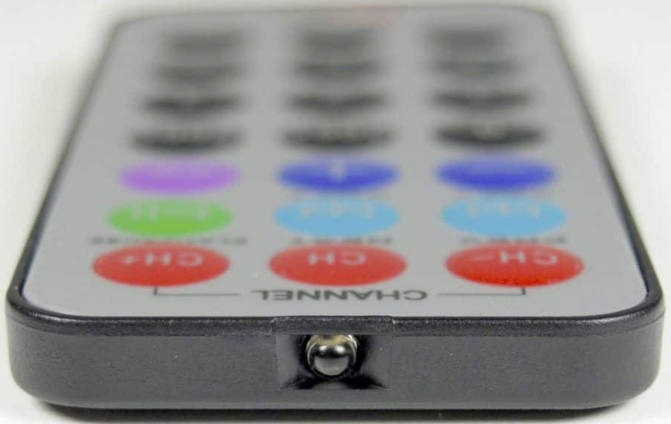
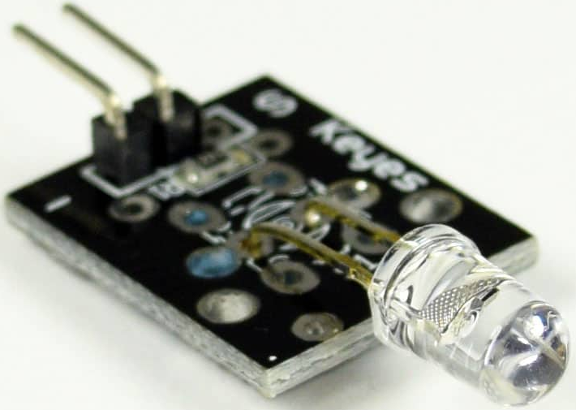
IR transmitter LED
An infrared communication system needs an IR transmitter and an IR receiver.
The IR transmitter resembles a standard LED but emits light in the IR spectrum.
The IR transmitter LED is visible on the front of a TV remote.

Slide 4
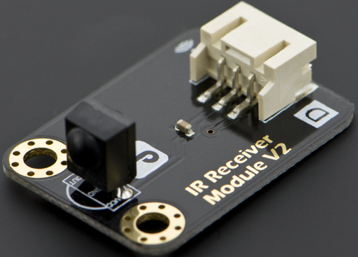
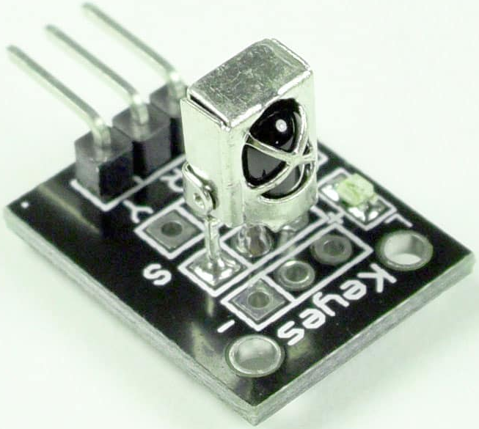
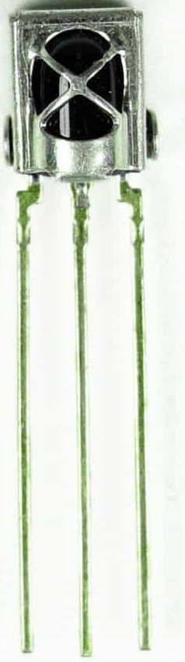
IR receiver
Photodiode
Amplifier
Converts the IR light into an electrical signal

Slide 5
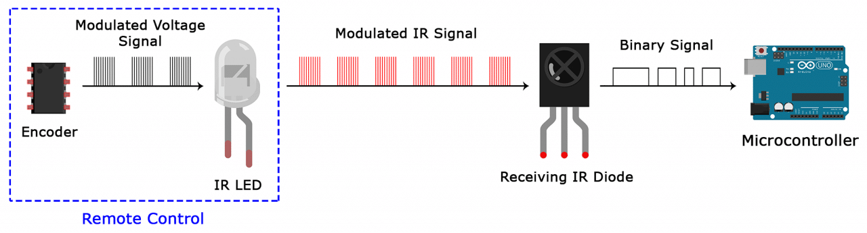
IR signal modulation
IR radiation is present all around us
In order to prevent these background IR noises from interfering with our signal
IR remote converts a binary signal into a modulated electrical signal.

Slide 6
IR signal modulation
The IR receiver then demodulates the IR light signal
converts back to binary, then passing to microcontroller

Slide 7
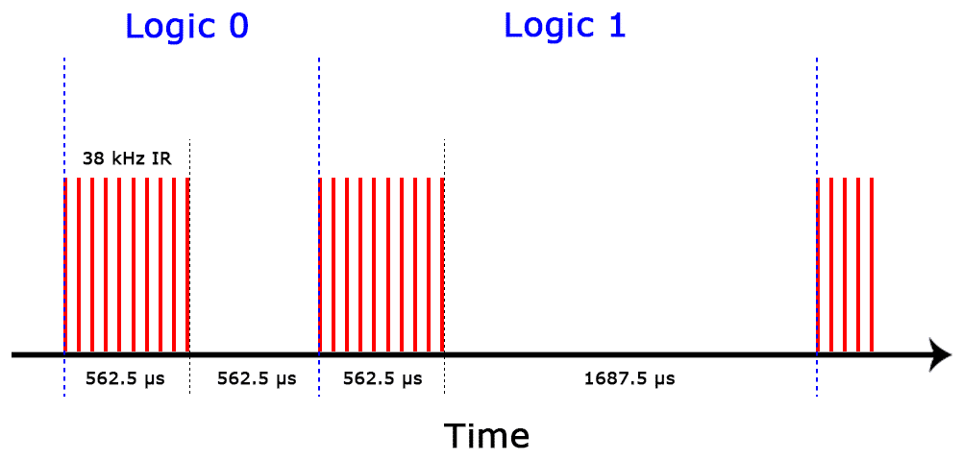
IR transmission protocol
Nec protocol
There are many IR transmission protocols. Sony, Matsushita, NEC, and RC5, NEC is the common type in Arduino projects
Logical ‘1’ starts with a 562.5 µs long HIGH pulse of 38 kHz IR followed by a 1,687.5 µs long LOW pulse.
Logical ‘0’ is transmitted with a 562.5 µs long HIGH pulse followed by a 562.5 µs long LOW pulse:

Slide 8
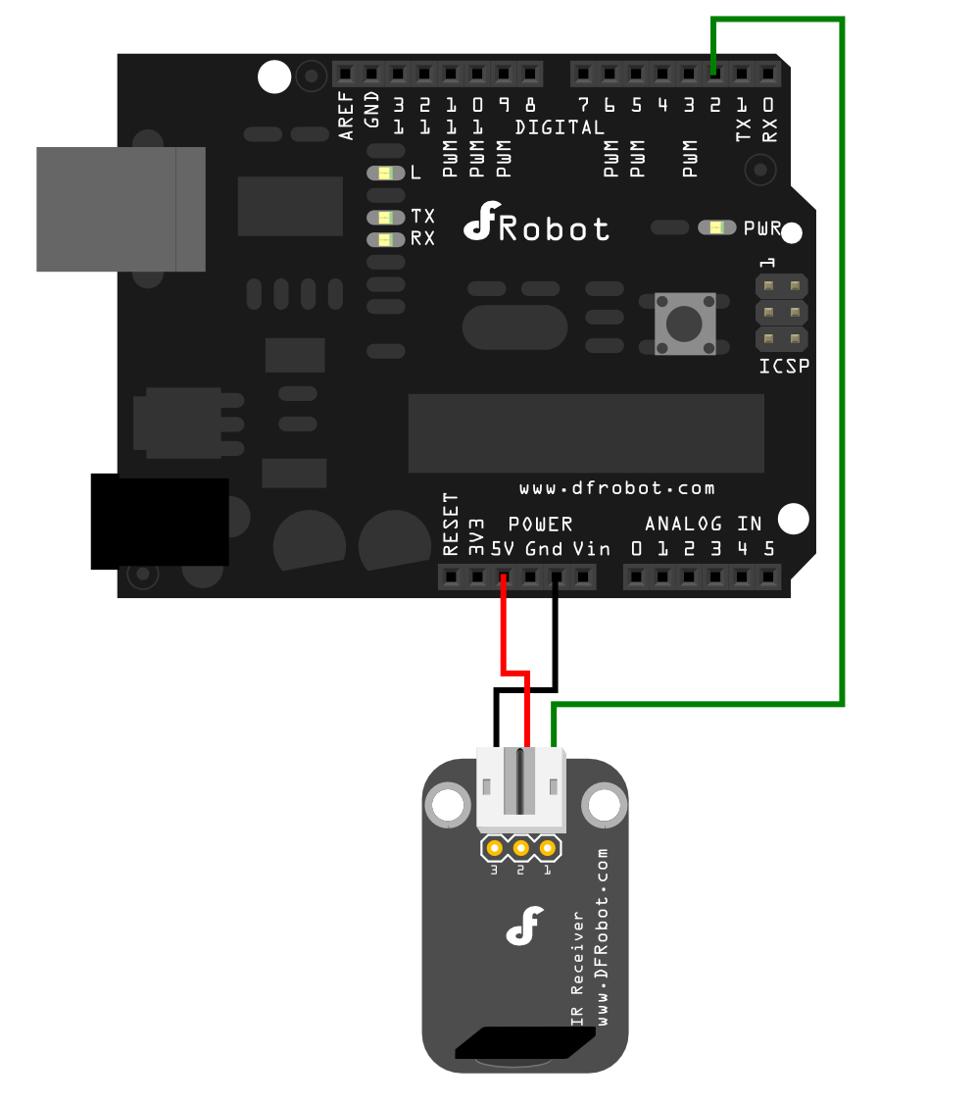
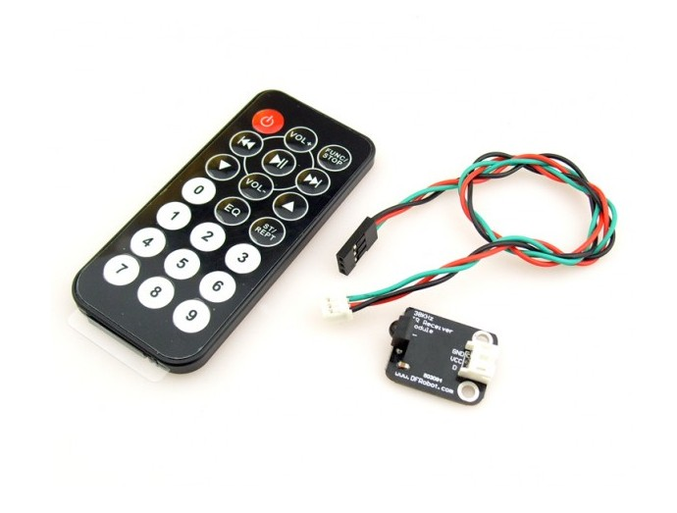
DF robot gravity IR kit Wiring
IR remote
IR Receiver
Pin3 - GND
Pin2 - 5V
Pin1 - D2
https://wiki.dfrobot.com/Digital_IR_Receiver_Module__SKU_DFR0094_#target_3

Slide 9
Code
includes the IRremote library
create IRrecv object named irrecv, using defined pin (RECV_PIN)
This create decode_results object named results that will store the decoded IR signals.
start serial communication
#include <IRremote.h>
int RECV_PIN = 11;
IRrecv irrecv(RECV_PIN);
decode_results results;
void setup()
{
Serial.begin(9600);
irrecv.enableIRIn();
}
void loop() {
if (irrecv.decode(&results)) {
Serial.println(results.value, HEX);
irrecv.resume();
}
}

Slide 10
Code
#include <IRremote.h>
int RECV_PIN = 11;
IRrecv irrecv(RECV_PIN);
decode_results results;
void setup()
{
Serial.begin(9600);
irrecv.enableIRIn();
}
void loop() {
if (irrecv.decode(&results)) {
Serial.println(results.value, HEX);
irrecv.resume();
}
}
Starts the IR receiver
Checks if an IR signal has been received and decoded. If a signal is available, the function returns true.
Prints the decoded IR signal value to the serial monitor in hexadecimal format.
Resumes the IR receiver, preparing it to receive the next IR signal.

